Slide 1
DIVYA.K
IPL Score Prediction USING MACHINE LEARNING AND DEEP LEARNING
3/21/2024 Annual Review

Slide 2


AGENDA
PROBLEM STATEMENT
PROJET OVERVIEW
WHO ARE THE END USERS?
SOLUTION AND ITS VALUE PROPOSITION
THE WOW IN SOLUTION
MODELLING
RESULT
3/21/2024 Annual Review

Slide 3

PROBLEM STATEMENT
Traditional cricket match prediction approaches often lack accuracy due to the oversight of crucial factors. These oversights lead to unreliable forecasts, impacting strategic decision-making and fan engagement. Our project aims to address this challenge by leveraging cutting-edge Machine Learning (ML) and Deep Learning (DL) methodologies, alongside multifactorial analysis, to enhance cricket match prediction accuracy.
3/21/2024 Annual Review

Slide 4

PROJECT OVERVIEW
Our project aims to revolutionize cricket match prediction by integrating multifactorial analysis and advanced ML/DL technologies. Using libraries like NumPy, Pandas, Scikit-learn, TensorFlow, and Matplotlib, we analyze player performance, match conditions, and historical trends. Predictive models provide stakeholders with actionable insights, and an interactive widget enhances fan engagement by allowing users to input match scenarios. Rigorous model training ensures reliable predictions, ultimately redefining cricket prediction accuracy.
3/21/2024 Annual Review

Slide 5

WHO ARE THE END USERS?
Team Management: Coaches, analysts, and managers for strategic planning, player
selection, and match tactics.
Broadcasters and Media: Reliance on predictions for pre-match analysis, commentary, and post-match discussions.
Betting and Gaming Platforms: Utilization of predictions to offer betting odds and create engaging experiences.
Cricket Fans: Engagement in interactive analysis to enhance viewing experience.
Cricket Associations and Governing Bodies: Use of predictions for scheduling, tournament planning, and team assessment.
Sponsors and Advertisers: Leverage predictions for targeted advertising and sponsorship opportunities.
3/21/2024 Annual Review

Slide 6

YOUR SOLUTION AND ITS VALUE PROPOSITION
Solution:
Utilizing the provided dataset, our solution employs a systematic approach to cricket match prediction. Leveraging TensorFlow and Keras, we develop a neural network model with Huber Loss, ensuring robustness.
Value Proposition:
Our solution offers accurate predictions through rigorous data preprocessing, model training, and evaluation. This empowers stakeholders with actionable insights for strategic decision-making, enhancing fan engagement and providing valuable opportunities for betting platforms and sponsors.
3/21/2024 Annual Review

Slide 7

THE WOW IN YOUR SOLUTION
▪
In-depth Data Analysis: Our solution utilizes multifactorial analysis to
consider player performance, match conditions, and historical trends,
ensuring a holistic prediction approach.
Cutting-edge ML/DL Techniques: Employing advanced TensorFlow and Keras models with Huber Loss, we achieve unparalleled accuracy in match forecasting.
Interactive Widget: Our intuitive ipywidgets-based widget enables users to engage directly with predictions, providing a personalized experience.
Strategic Insights: By delivering precise predictions and actionable insights,
our solution enhances decision-making and fan engagement, setting new standards in cricket analytics.
3/21/2024 Annual Revie
w
8

Slide 8
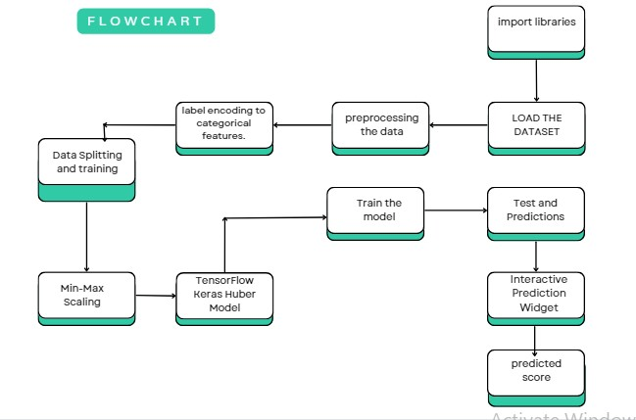
MODELLING
Teams cam add wireframes
3/21/2024 A nual Review
8
n

Slide 9
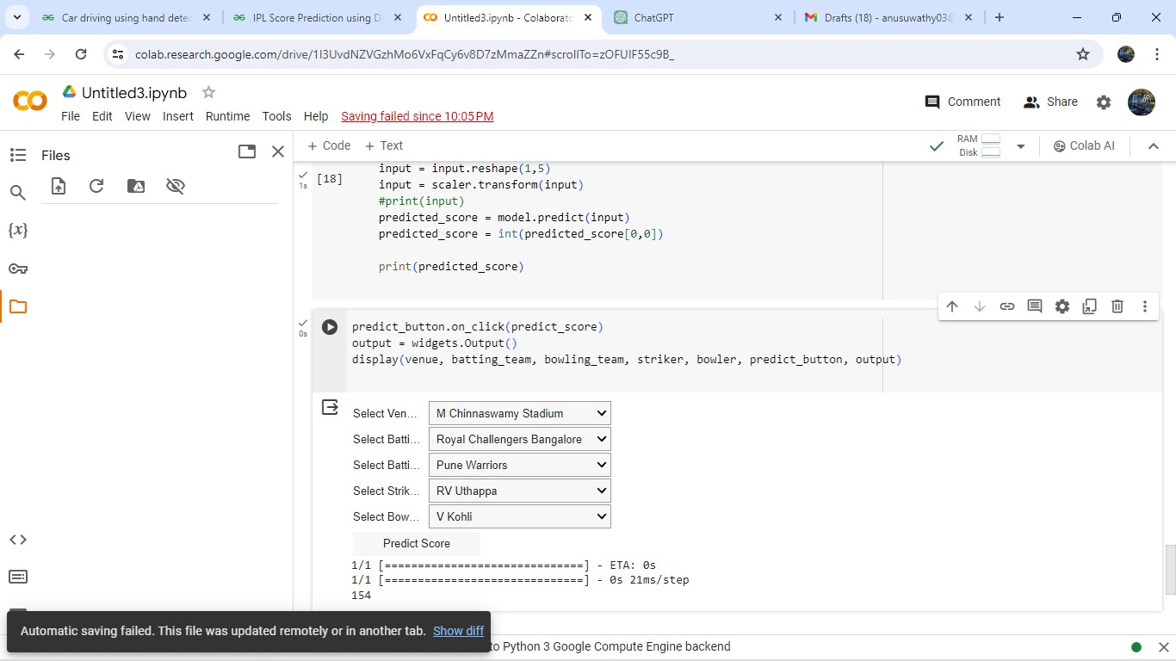
RESULTS
https://github.com/Sivasankari0510/NaanMudhalvan_GenAI.git
3/21/2024 A nual Review
9
n

Slide 10
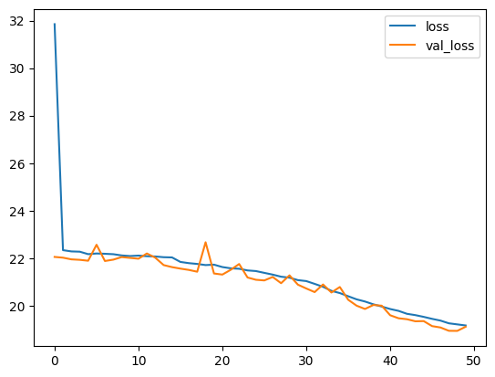
Result:

Slide 11
Conclusion:
Utilizing machine learning and deep learning for IPL score prediction yields promising results, considering historical match data and player statistics. Models like random forests, support vector machines, and neural networks effectively capture various factors influencing match outcomes. However, the reliability of predictions hinges on data quality, feature engineering, and unforeseen match dynamics like injuries or weather conditions. Ensembling techniques can enhance prediction accuracy by combining diverse model strengths. Continuous refinement and incorporation of domain expertise are vital for improving the robustness of IPL score prediction systems.

